Slide 1
DIGITAL ELECTRONICS
UNIVERSAL LOGICAL GATES

Slide 2
Introduction
A universal logic gate is a logic gate that can be used to construct all other logic gates. There are many articles about how NAND and NOR are universal gates, but many of these articles omit other gates that are also universal gates. This article covers two input logic gates, demonstrates that the NAND gate is a universal gate, and demonstrates how other gates are universal gates that can be used to construct any logic gate.

Slide 3

UNIVERSAL LOGICAL GATES

Slide 4
WHAT IS A NAND GATE?
The NAND gate or “Not AND” gate is the combination of two basic logic gates, the AND gate and the NOT gate connected in series. The NAND gate
and NOR gate can be called the universal gates since the combination of these gates can be used to accomplish any of the basic operations.

Slide 5
Hence, NAND gate and NOR gate combination can produce an inverter, an OR gate or an AND gate.
The output of a NAND gate is high when either of the inputs is high or if both the inputs are low. In other words, the output is always high and goes
low only when both the inputs are high. The logic NAND function is given by the Boolean expression. Here A, B are the inputs and Y is the output. The Boolean expression given for a NAND gate is that of logical addition and it is opposite to AND gate. The Boolean expression is given by a single dot (.) with an over line over the expression to show the NOT or the logical negation of the NAND gate.

Slide 6
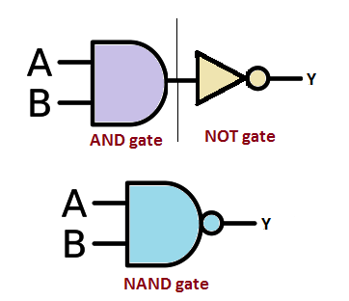
THE TRUTH TABLE OF A NAND GATE IS GIVEN BELOW
A | B | Y
0 | 0 | 1
0 | 1 | 1
1 | 0 | 1
1 | 1 | 0

Slide 7
s. The truth table of a 2 input NOR gate can be represented as:
WHAT IS A NOR GATE?
A NOR gate (“not OR gate”) is a logic gate that produces a high output (1) only if all its inputs are false, and low output (0) otherwise. Hence the NOR gate is the inverse of an OR gate, and its circuit is produced by connecting an OR gate to a NOT gate. Just like an OR gate, a NOR gate may have any number of input probes but only one output probe.
A NOT GATE followed by an OR gate makes a NOR gate. The basic logic construction of the NOR gate is shown below:
The symbol of the OR gate is similar to the OR gate but one bubble is drawn at the output point of the OR gate in the case of the OR gate.

Slide 8
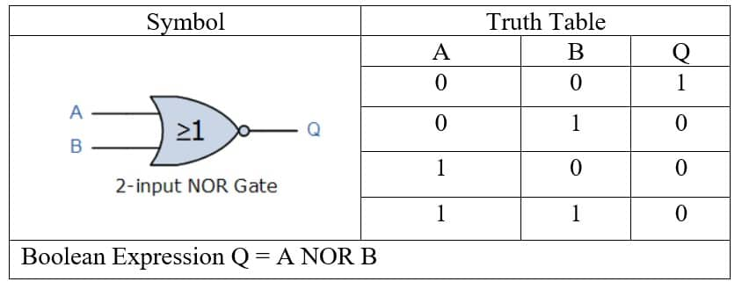
NOR GATE TRUTH TABLE
NOR gate means “not an OR gate” hence the output of this logic gate is just the reverse of that of an OR gate.
We know that the output of an OR gate is 0 only when all inputs of the OR gate are 0. Hence in the case of the NOR gate, the output is 1 only when all inputs are 0. In all other cases, that is for all other combinations of inputs the output is 0.
Truth tables list the output of a particular digital logic circuit for all the possible combinations of its inputs. The truth table of a 2 input NOR gate can be represented as:

Slide 9


